Slide 1
PAP SMEAR
DR. narges zamani
Assistant professor of gynecologic oncology

Slide 2
Cervical cancer
Common among women worldwide
Most cases occur in developing countries
Screening and vaccination can decrease incidence and mortality rate in cervical cancer
Screening can detect precursors and early-stage disease
Treatment of these diseases can prevent the development of invasive cervical cancer

Slide 3
When should start being screened for cervical cancer ?
Starting at age 21 years
Continuing up to 65 years

Slide 4
What tests are used to Screen for cervical cancer ?
Pap test ( every three years)
HPV testing ( every five years)
Both ( every five years)

Slide 5
What happens during a Pap or HPV test ?
After inserting a speculum, use a spatula to scrape cells from the surface of the cervix
Taking cells from the surface of the the cervix and sending them to a lab
An expert look at the cells under a microscope to see if they are abnormal

Slide 6


Slide 7
Factors with limited or no effects on sampling
Menses or other genital tract bleeding
Interval between Pap tests
Gel lubricants and other contaminants
Vaginal intercourse ,douching and tampon

Slide 8
Do need to be screened if had hysterectomy?
do NOT need screening if :
  Cervix was removed completely
  Not have cervical cancer or precancer

Slide 9
Do need to get screening tests if had the HPV vaccine?
should still be screened for cancer or precancer.

Slide 10
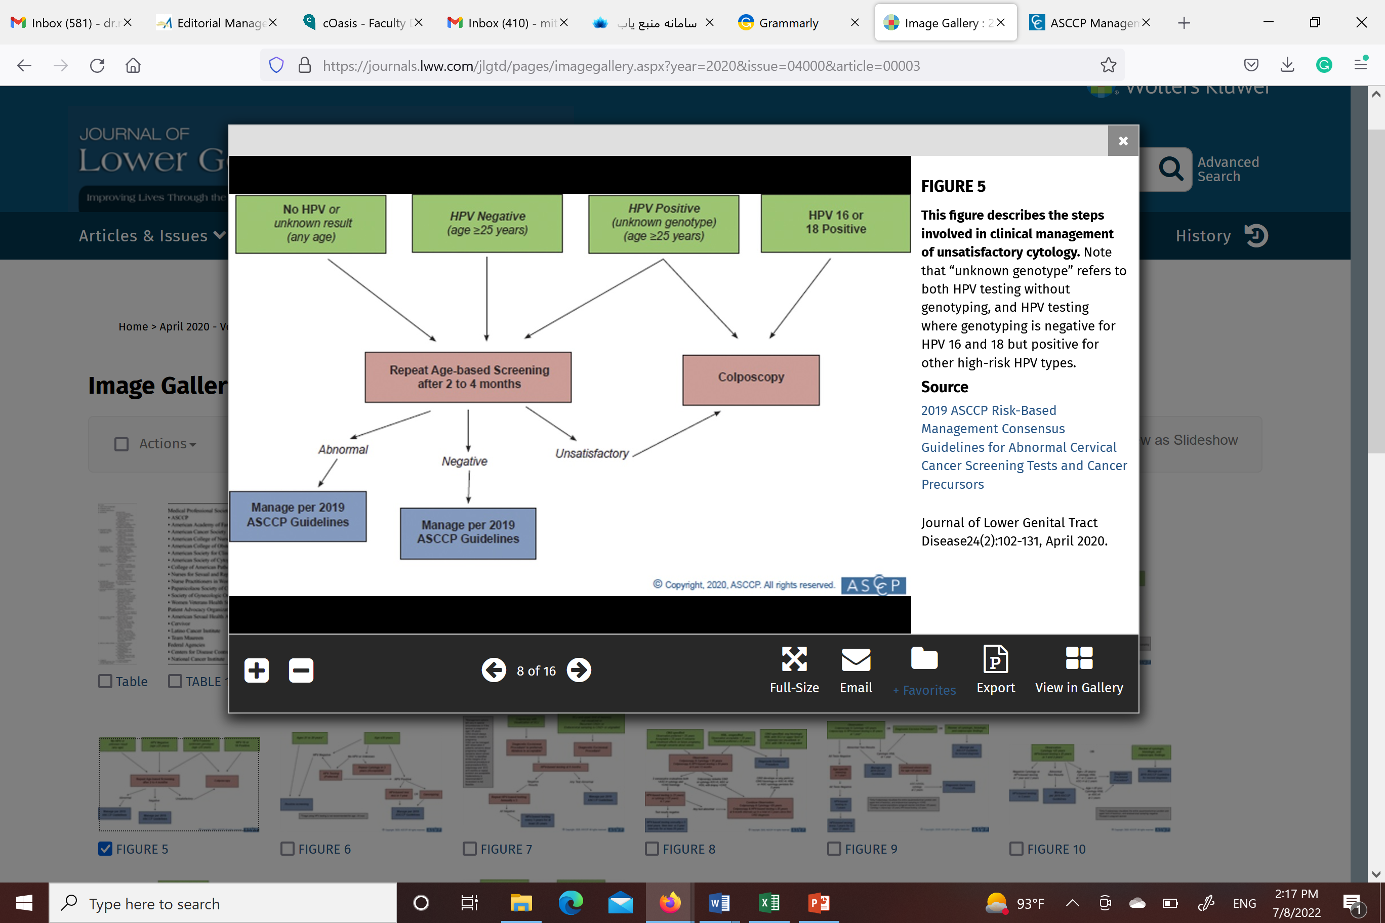
Unsatisfactory cytology

Slide 11
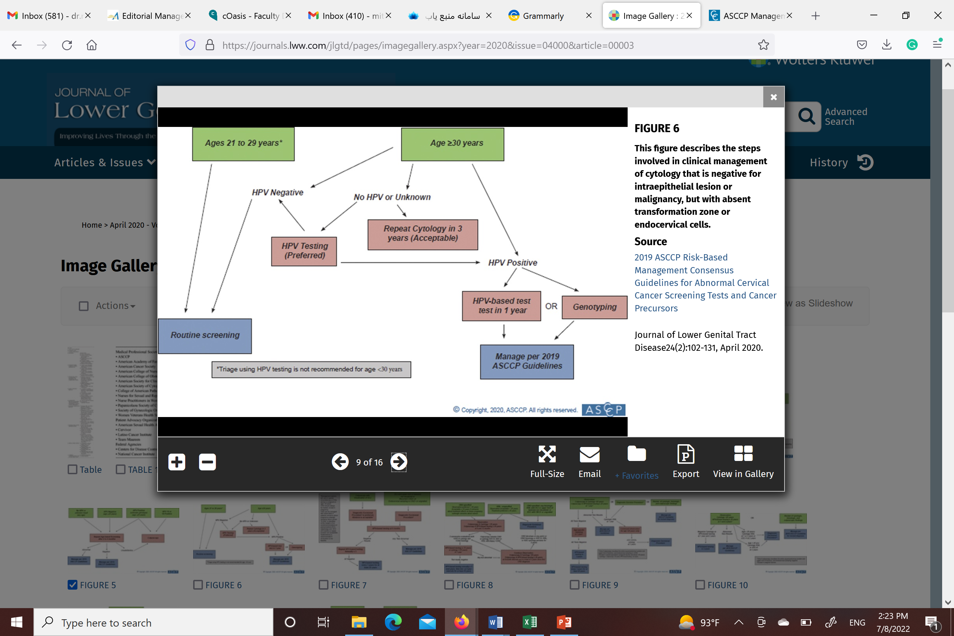
Absent endocervical cells

Slide 12
Non neoplastic findings
Infectious organisms
Reactive changes and inflammation

Slide 13
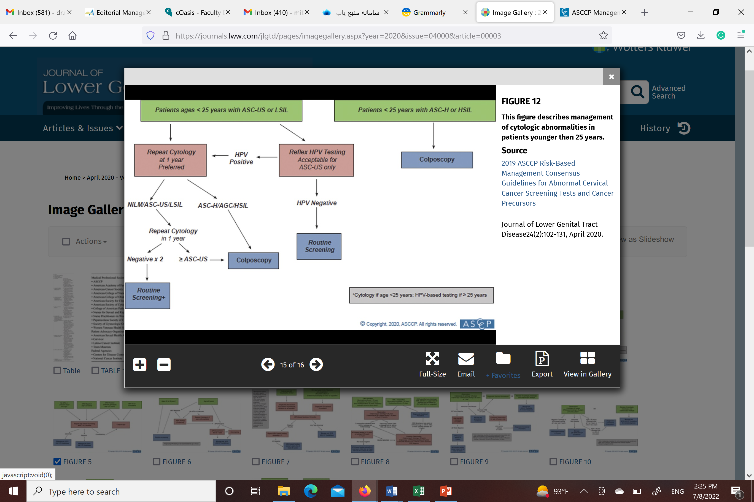
Patients ages < 25 years

Slide 14
HPV+,NILM
Colposcopy
HPV 16+ or 18+ or History of HPV+
1-y Follow-up
Others

Slide 15

ASCUS
HPV test
HPV+
colposcopy
1-y Follow-up
HPV-
3-y Follow-up

Slide 16
Patient 1
32years
Current :ASCUS HPV+
History : unknown
colposcopy

Slide 17
Patient 2
32years
Current :ASCUS HPV+
History : HPV -
1-Y Follow-up

Slide 18
LSIL
HPVtest
HPV+
colposcopy
1-y Follow-up
HPV-
1-y Follow-up

Slide 19
Patient 3
45years
Current :LSIL HPV+
History : unknown
colposcopy

Slide 20
Patient 4
32years
Current :LSIL HPV+
History : HPV -
1-Y Follow-up

Slide 21
ASCH HSIL AGC
COLPOSCOPY

Slide 22
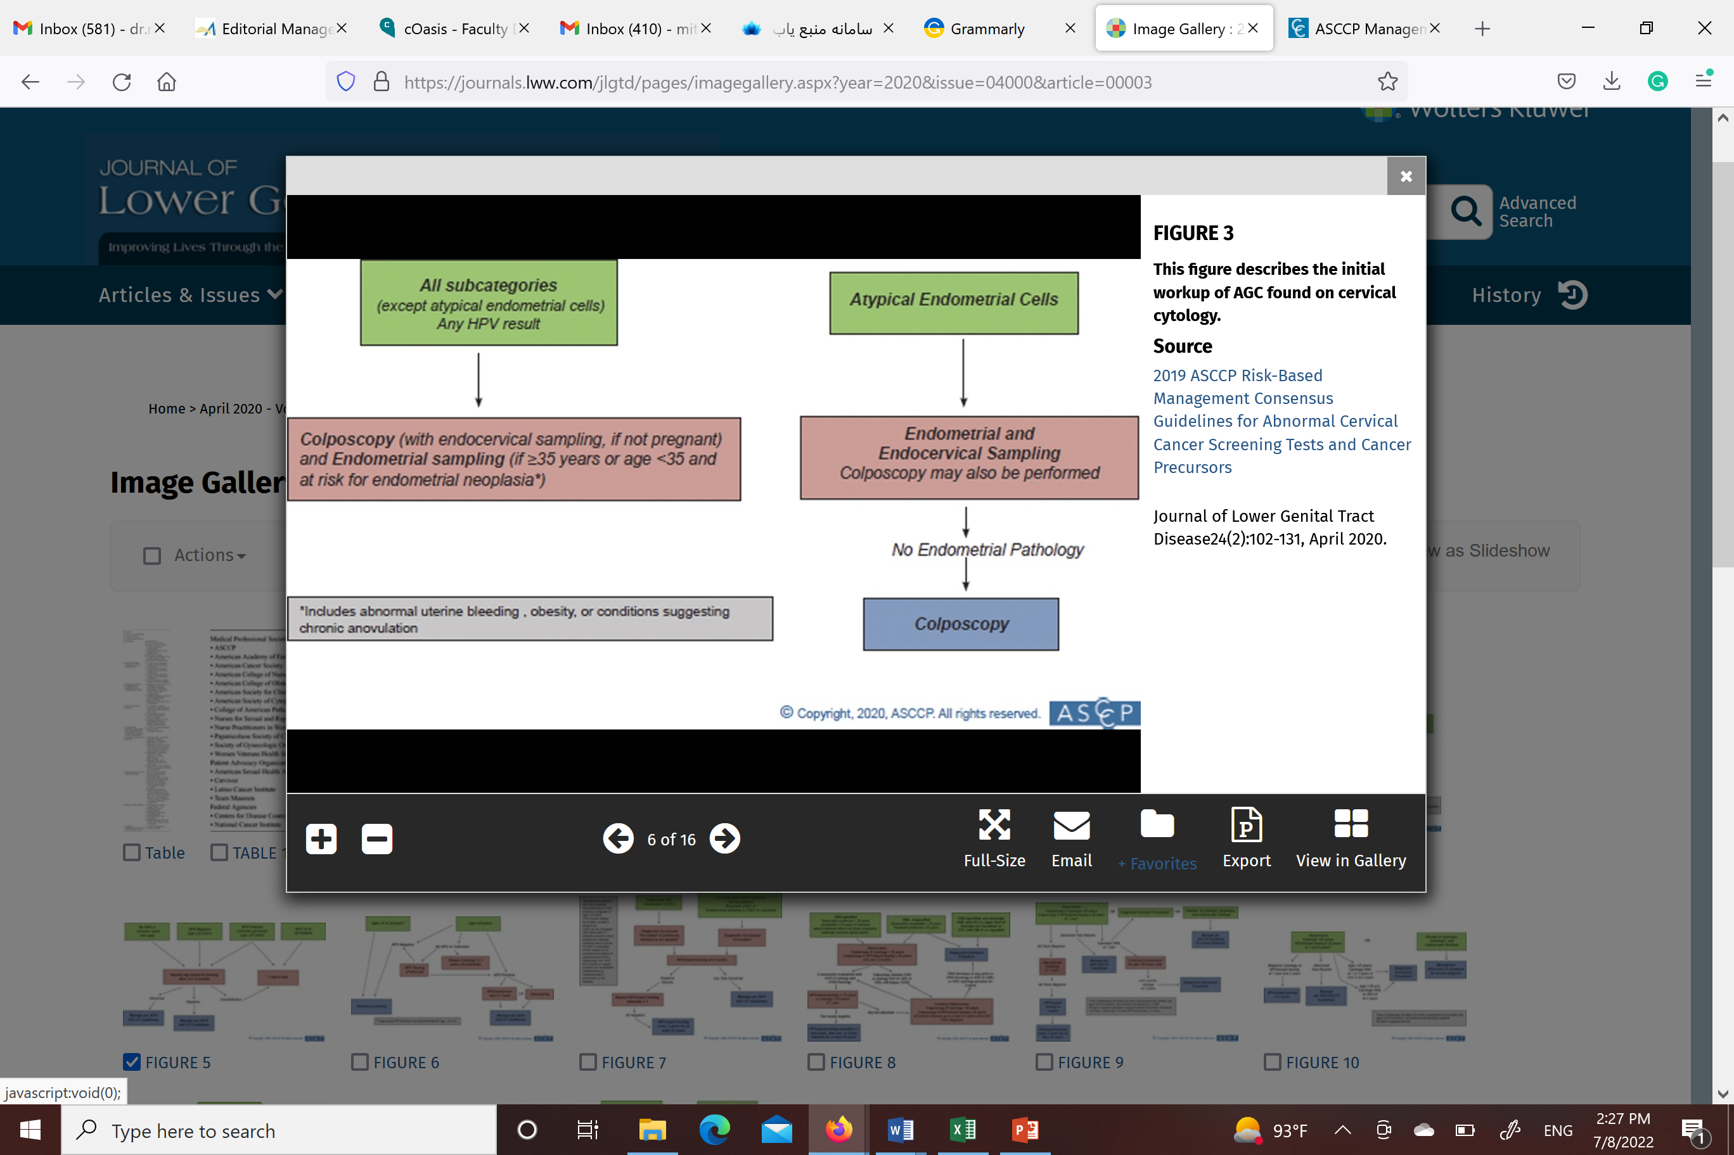
AGC

Slide 23
Benign-appearing endometrial cells in women > 45 y
Evaluation for hyperplasia or cancer
menoposual
Abnormal Bleeding
Premenoposual with risk factor

